Slide 1



LogSentiel(AI)
AL-POWERED IT TROUBLESHOOTING SYSTEM
RAG + Compression + Validation + Escalation
-Ishani Ghosh(24BCE5187)
VIT CHENNAI STUDENT

Slide 2
TABLE OF CONTENTS
01
02
03
04
05
PROBLEM STATEMENT
PROPOSED SOLUTION
PROJECT STRUCTURE
ARCHITECTURE
FUTURE ENHANCEMENT

Slide 3


PROBLEM STATEMENT:
Develop a RAG system for IT troubleshooting that compresses error logs and solution databases, reducing latency in critical support scenarios.

Slide 4
WHAT ARE WE WORKING ON?
DEVELOP
IMPROVE
EXCELL
We enhance troubleshooting accuracy by compressing large error logs and retrieving the most relevant historical cases using semantic search. Agent-1 generates grounded, structured solutions, while Agent-2 validates the response and assigns a confidence score to ensure reliability and controlled escalation.
Enterprise-ready architecture with dual-agent validation, local LLM security, structured remediation steps, and automated JIRA escalation for reliable real-world support.
We build a Dual-Agent RAG-based IT Troubleshooting System that ingests large error logs (10,000+ lines), compresses them intelligently, retrieves similar historical issues, and generates structured, step-by-step solutions using a local LLM.

Slide 5
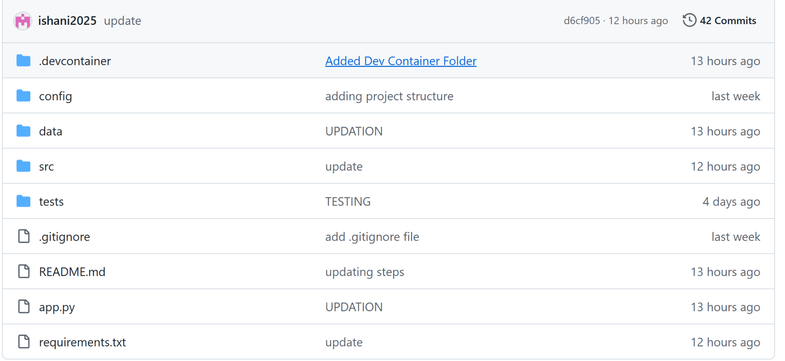
:
app.py: This is the runtime entry point and high-level coordinator. It wires together configuration, retrieval logic, agents, and LLM interaction. When the program runs, this file initializes the pipeline, loads models or indexes, receives the user input (likely an error log), and triggers the decision flow. In practical terms, app.py governs control flow and lifecycle management, not core algorithms.
PROJECT STRUCTURE

Slide 6
Agents (src/agents/agent1.py, agent2.py) :These files implement role-based reasoning. Agent 1 typically handles analysis and retrieval-centric tasks (understanding logs, querying the knowledge base), while Agent 2 focuses on resolution or escalation decisions. The separation mirrors enterprise support systems where diagnosis and remediation are decoupled. These modules encapsulate behavioral logic rather than infrastructure.
search.py – Retrieval Operator
This module executes similarity queries against the vector store and returns ranked candidates. It typically defines top-K logic, filtering, and scoring behavior. Functionally, it is the bridge between embeddings and reasoning, transforming vector proximity into usable knowledge snippets for agents or the LLM.
Preprocessing Modules – Data Conditioning Pipeline
Files such as clean_dataset.py, error_extractor.py, and stacktrace_normalizer.py transform noisy logs into structured, semantically meaningful data. They remove variability, normalize stack traces, and extract error signatures. These modules are strategically important because retrieval systems are highly sensitive to data quality; poor normalization degrades similarity performance more than model choice.

Slide 7
log_compressor.py – Log Optimization Layer
This component reduces log verbosity by removing redundant or low-signal content. Its role is not merely storage reduction but improving downstream processing efficiency and signal-to-noise ratio. In systems handling large logs, this module directly affects memory usage, retrieval speed, and model input limits.
LLM Interface (client_llm.py) – Model Abstraction
client_llm.py isolates model interaction details (API calls, parameters), while response_parser.py cleans and structures model outputs. This abstraction prevents LLM dependencies from contaminating business logic. It also simplifies swapping models or providers — a design choice aligned with scalable architectures.
OUR dataset resides at data/kb_issues/final_dataset_agent1_cleaned.json
final_dataset_agent1_cleaned—>The file is structured as a JSON array where each element represents a single error or failure instance captured as a knowledge record. Every record follows a consistent schema designed for retrieval-augmented reasoning. The title field provides a human-readable summary of the issue, functioning as a descriptive identifier rather than a computational signal. The error_type field contains the normalized exception class (for example, java.lang.NullPointerException), which serves as a strong semantic anchor for similarity matching and clustering. The stack_trace field is stored as an array of lines instead of a single string, preserving execution context while allowing downstream normalization, truncation, or pattern analysis. The source field specifies the origin of the record (such as GitHub), enabling metadata-aware filtering or weighting. The knowledge_text field is a flattened, cleaned textual representation of the error scenario and is the most critical component for embedding generation and semantic retrieval, as vector models operate more reliably on coherent text than raw traces. Finally, the root_cause field provides a human-interpretable explanation or placeholder, acting as a potential supervision or reasoning signal rather than a retrieval driver. Collectively, this schema is optimized for vector search, where knowledge_text, error_type, and stack_trace form the core signals influencing retrieval quality.

Slide 8
WORKFLOW
The compressed log is converted into embeddings.
FAISS performs similarity search over the structured troubleshooting dataset.
Top relevant historical cases are retrieved with similarity scores.
Agent-2 evaluates the generated solution.
It checks grounding strength and assigns a confidence level (Low / Medium / High).
The final output is displayed in the Streamlit dashboard along with system metrics.
SEMANTIC RETRIEVAL
AGENT-2 VALIDATION
LOG INGESTION & COMPRESSION
AGENT-1 SOLUTION GENERATION
Users paste large error logs into the Streamlit interface. The system performs deterministic extraction of exception type and key stack traces. Logs are compressed to reduce token size before processing.
Agent-1 (Local LLM via Ollama) generates a structured, step-by-step resolution. The response is grounded in retrieved cases to minimize hallucination. Root cause and remediation steps are clearly structured.

Slide 9
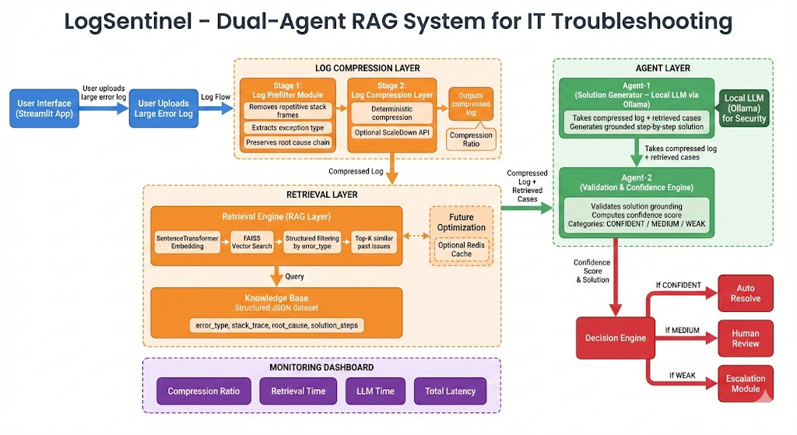
ARCHITECTURE

Slide 10
FUTURE ENHANCEMENTS
Redis Caching Layer
JIRA Integration for Escalation
Introduce Redis to cache frequently retrieved embeddings and solutions, reducing repeated computation and significantly lowering response latency.
Integrate automated JIRA ticket creation for low-confidence cases, enabling seamless human intervention and enterprise workflow alignment.
Advanced Search & Public Deployment Strategy
Production-Grade Scalability with Celery
Implement Celery for asynchronous task processing to handle high concurrency (e.g., 1000+ users) without blocking the main application, ensuring system stability under load.
Enhance retrieval using hybrid search (semantic + keyword) and deploy the system as a publicly accessible API with authentication and rate limiting.

